Slide 1


Practice all the operators with sample data

Slide 2
Data Modeling

Slide 3
Data Modeling Introduction
Before inserting data, MongoDB’s collections do not enforce document structure.
The key challenge in data modeling is balancing the needs of the application.
When designing data models, always consider the application usage.
i.e. queries, updates, and processing of the data.

Slide 4
Document Structure
The key decision in designing data models for MongoDB applications revolves around the structure of documents.
There are two tools that allow applications to represent:-
    references
    embedded documents.

Slide 5
References
References store the relationships between data by including links or references from one document to another.
These are normalized data models.

Slide 6
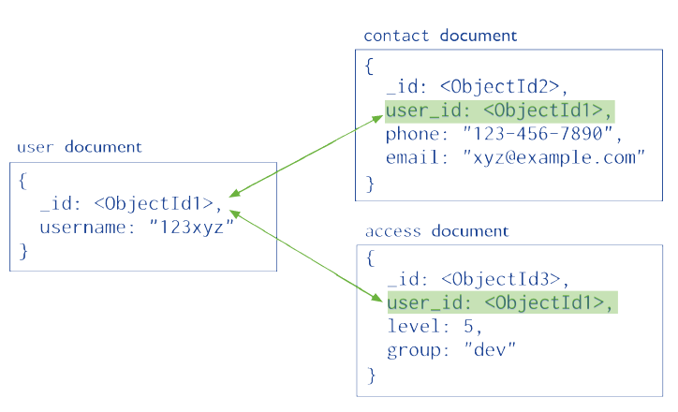
References

Slide 7
Embedded Data
Embedded documents capture relationships between data by storing related data in a single document structure.
MongoDB documents make it possible to embed document structures in a field or array within a document.
These denormalized data models allow applications to retrieve and manipulate related data in a single database operation.

Slide 8
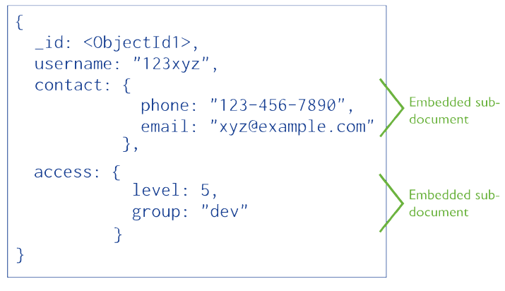
Embedded Data

Slide 9
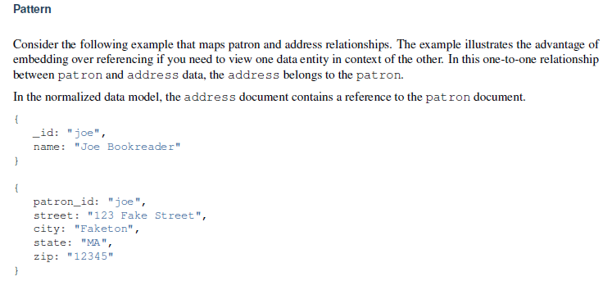
Model One-to-One Relationships with Embedded Documents

Slide 10
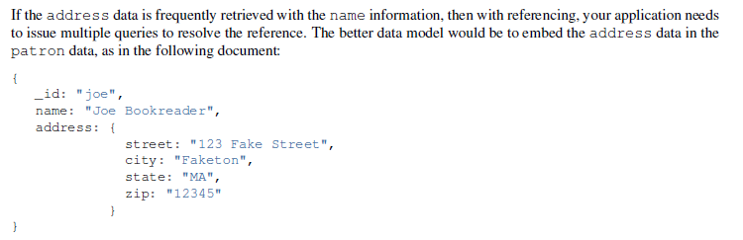
Model One-to-One Relationships with Embedded Documents
Solution:-

Slide 11
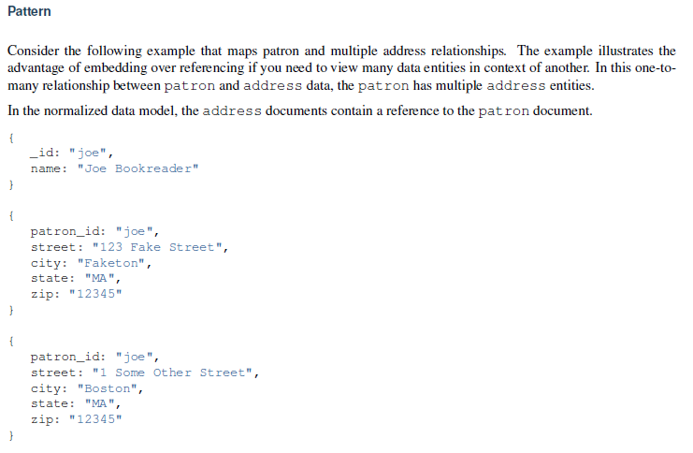
Model One-to-Many Relationships with Embedded Documents

Slide 12
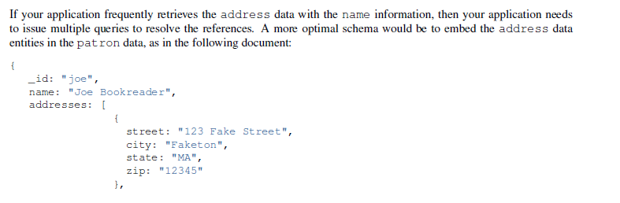
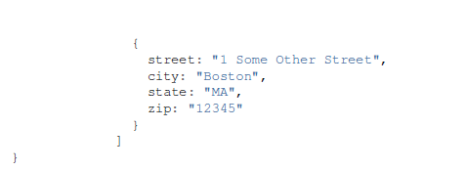
Model One-to-Many Relationships with Embedded Documents
Solution:-

Slide 13
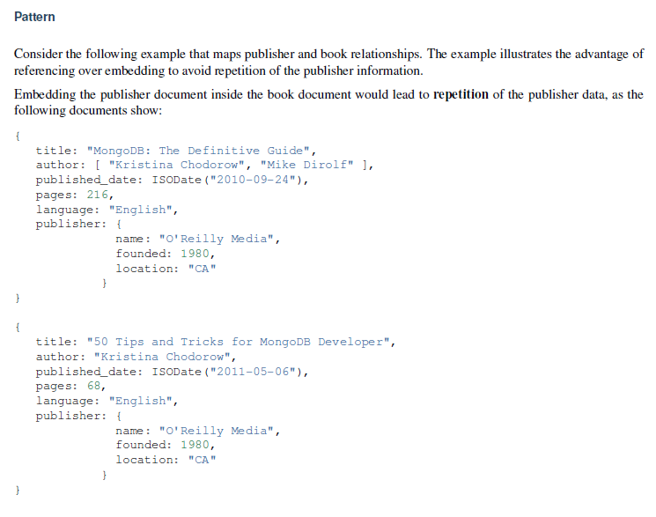
Model One-to-Many Relationships with Document References

Slide 14
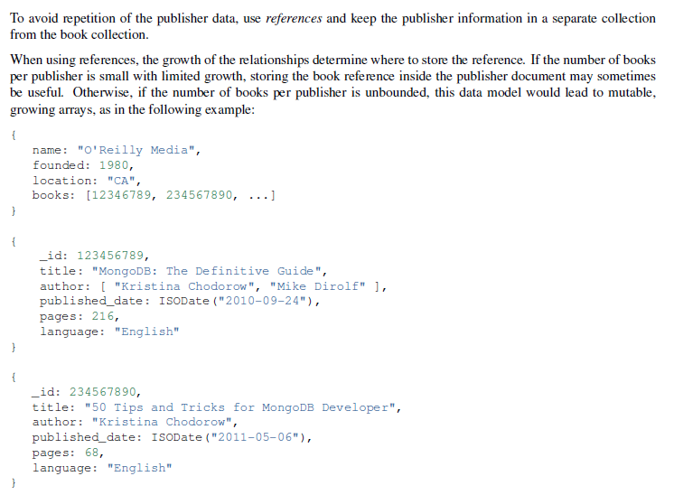
Solution:-

Slide 15
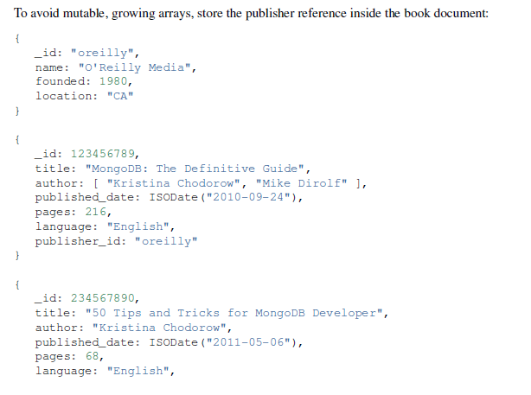
Solution:-

Slide 16

Practice all the data models with sample data
Design database to store Employee information.
      employee information.
      Department information.
      Attendance information .
      Note:- design with efficient schema

